Slide 1

What you listen to says a lot about who you are
Notes:
Source: https://www.google.com/url?sa=i&url=https%3A%2F%2Fwww.pinterest.com%2Fpin%2F110690103327155160%2F&psig=AOvVaw2tvv-2tiUN4DcT1I4zQm76&ust=1607020242054000&source=images&cd=vfe&ved=0CAIQjRxqFwoTCOj664v3r-0CFQAAAAAdAAAAABAE

Slide 2
Data Visualisation & Story Telling
Final Group Project
Study Group 14
Notes:
Source: https://www.google.com/url?sa=i&url=https%3A%2F%2Fwww.pinterest.com%2Fpin%2F110690103327155160%2F&psig=AOvVaw2tvv-2tiUN4DcT1I4zQm76&ust=1607020242054000&source=images&cd=vfe&ved=0CAIQjRxqFwoTCOj664v3r-0CFQAAAAAdAAAAABAE

Slide 3


1
Introduction
2
Our preferences
3
Song popularity
4
Conclusion

Slide 4

Have you ever thought about the data behind the music that you listen to every day?
1
Introduction
2
Our preferences
3
Song popularity
4
Conclusion
LET’S HAVE A LOOK
Notes:
Music taste is something that is so different to describe, why not visualise it instead?

Slide 5





LEARN MORE
Did you know you could find data on all your favourite songs with Spotify for Developers’ API?
Friend Activity
Filippo
1
Introduction
Metadata about music artists, albums, and tracks can be retrieved directly from the Spotify Data Catalogue.
Features that are recorded for each track
Popularity
Higher popularity for songs that are being played a lot now compared to songs that were played a lot in the past. Artist and album popularity is derived mathematically from track popularity.
Properties:
Loudness: loud music is usually high in decibels (dB)
Liveness: detects the presence of audience (more audience higher liveness)
Speechiness: whether there is presence of spoken works (audio books have a high speechiness)
Explicit: Whether or not the track has explicit lyrics
Tempo: whether the overall beats per minute (BPM) is fast or slow
Duration_ms: track length in milliseconds
Mood:
Danceability: how suitable a song is for dancing, calculated based on tempo, beat, etc.
Valence: tracks with high valence sound more positive (happy and cheerful)
Energy: measure of a track’s intensity and activity; high energy is typically loud and noisy
Context
Acousticness: whether the music uses acoustic instruments, rather than electrical equipment
Instrumentalness: whether the music has a lot of instruments or just vocals
Jason
2
Our preferences
Marie
3
Song popularity
Ruchen
4
Conclusion
Sammy
Notes:
https://developer.spotify.com/documentation/web-api/reference/object-model/

Slide 6
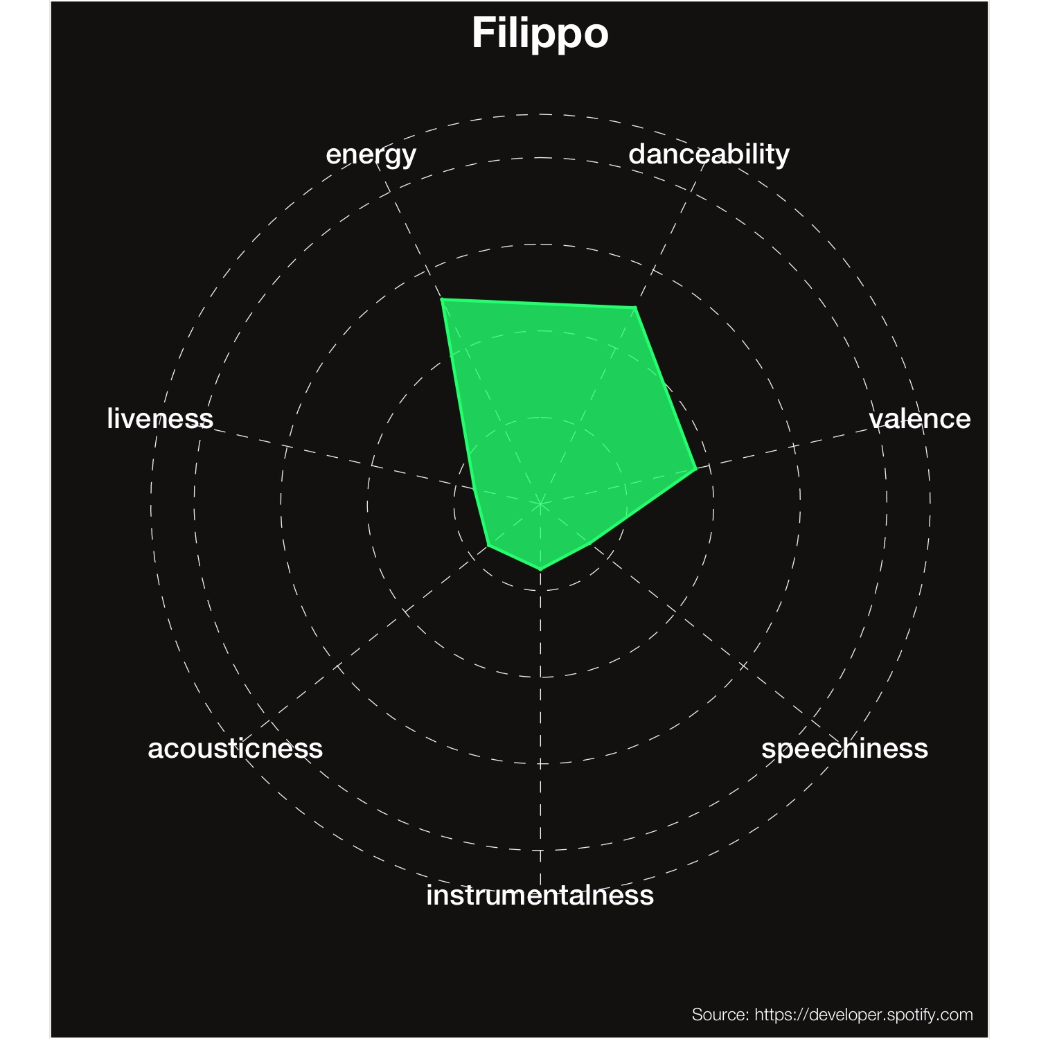
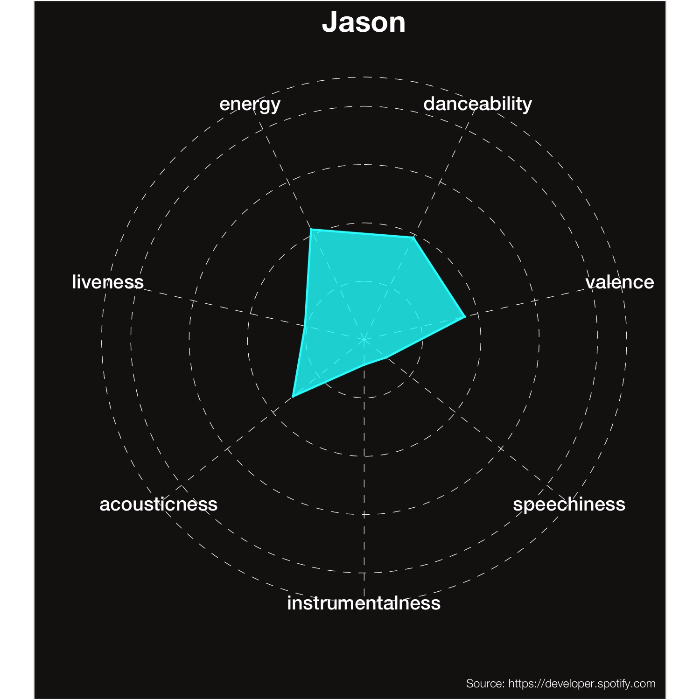
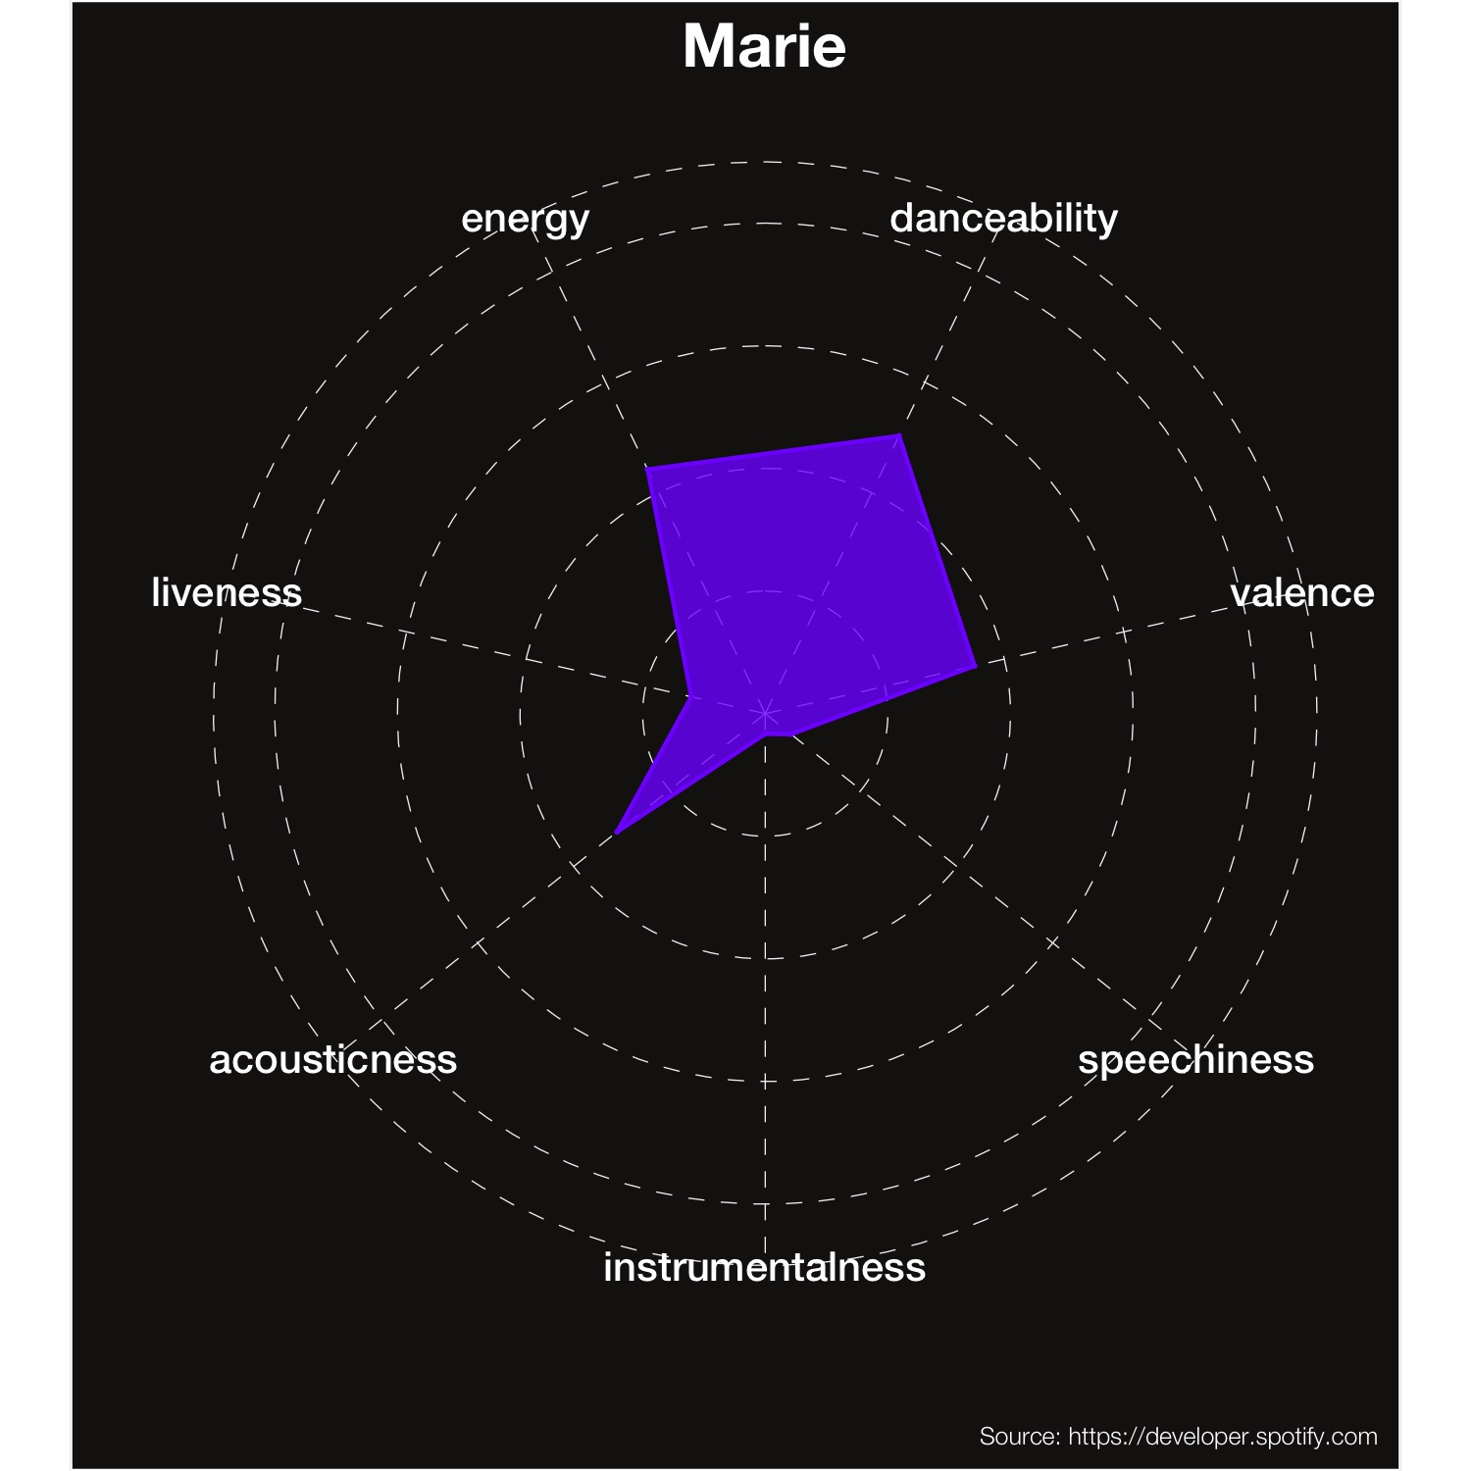
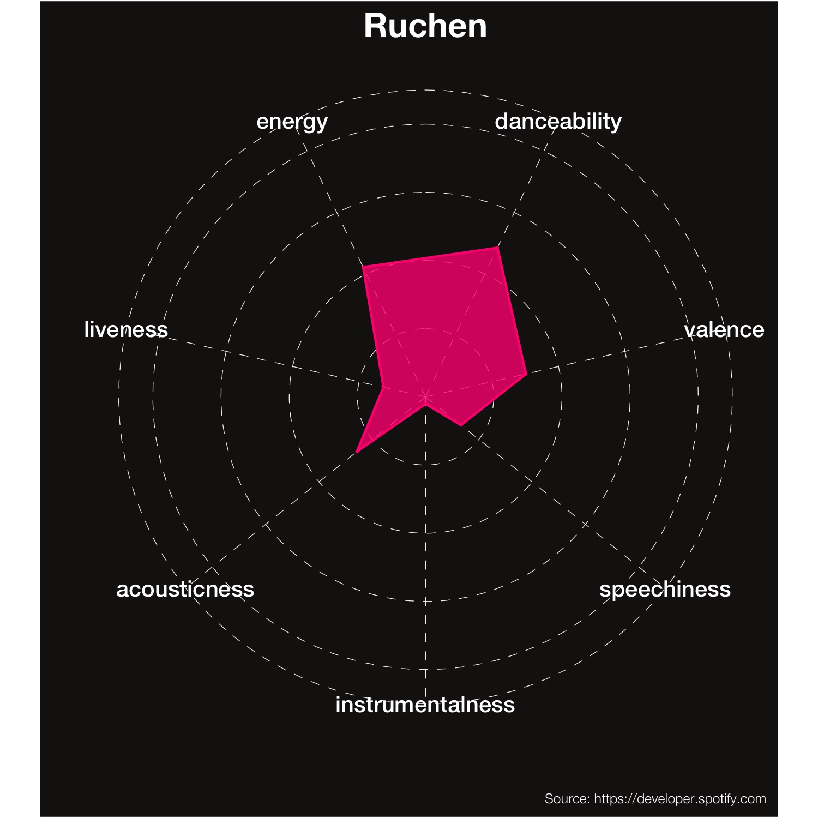
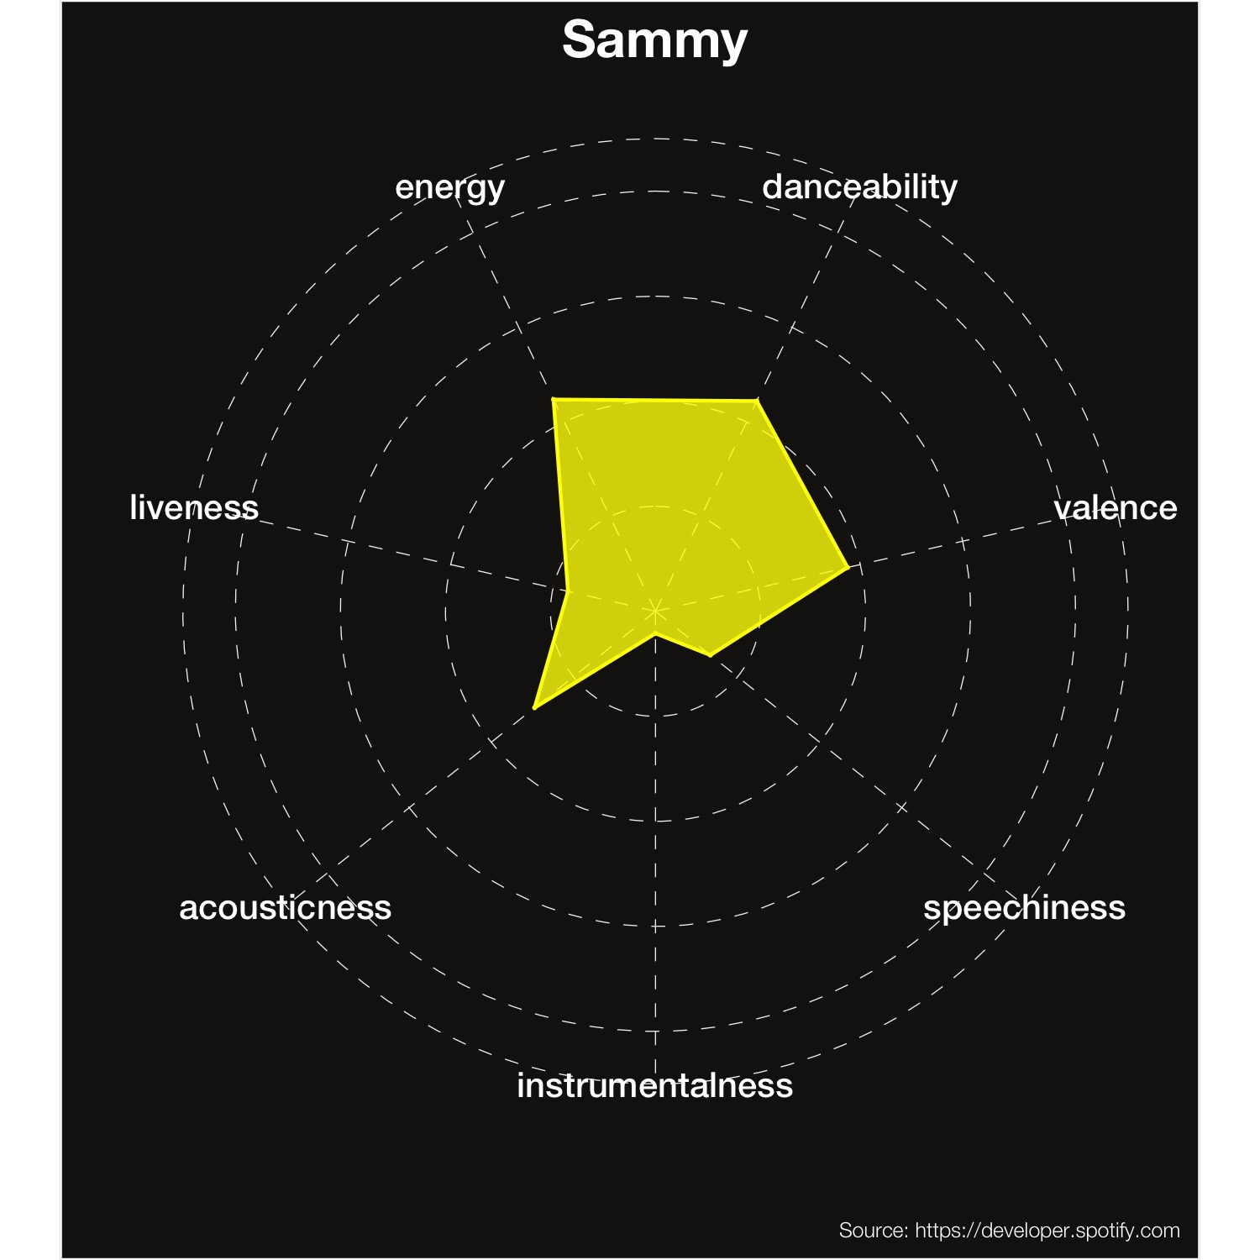
Seems like we listened to similar music in 2020…
1
Introduction
2
Our preferences
3
Song popularity
4
Conclusion

Slide 7
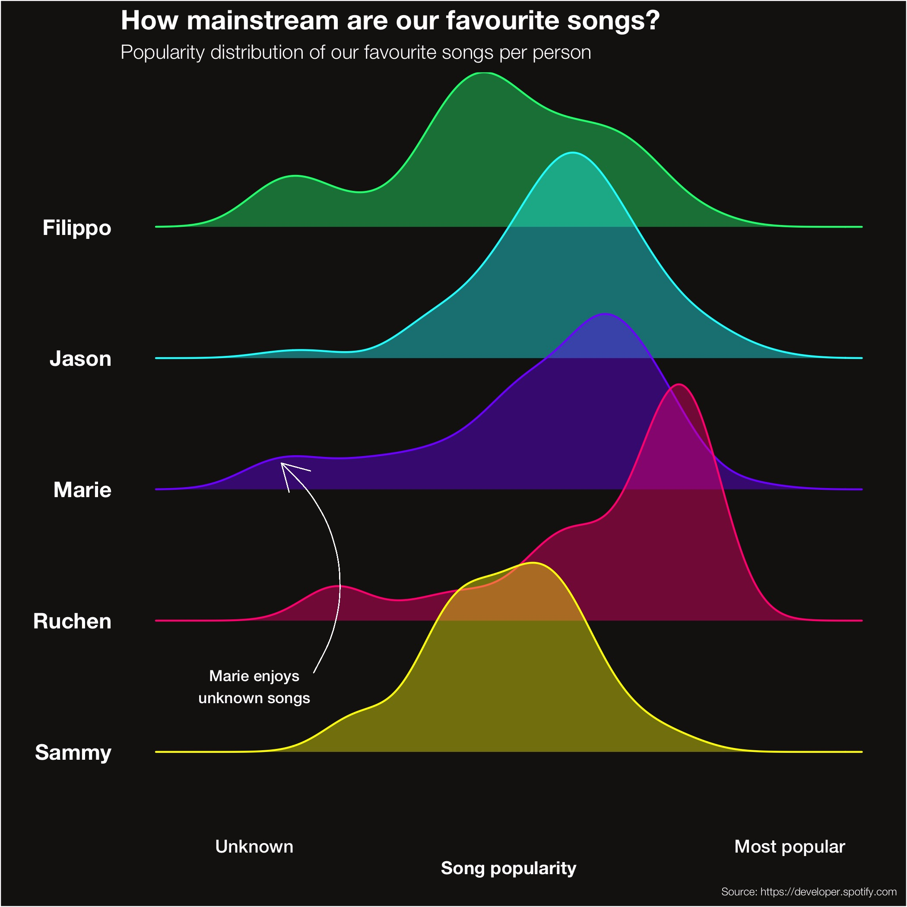
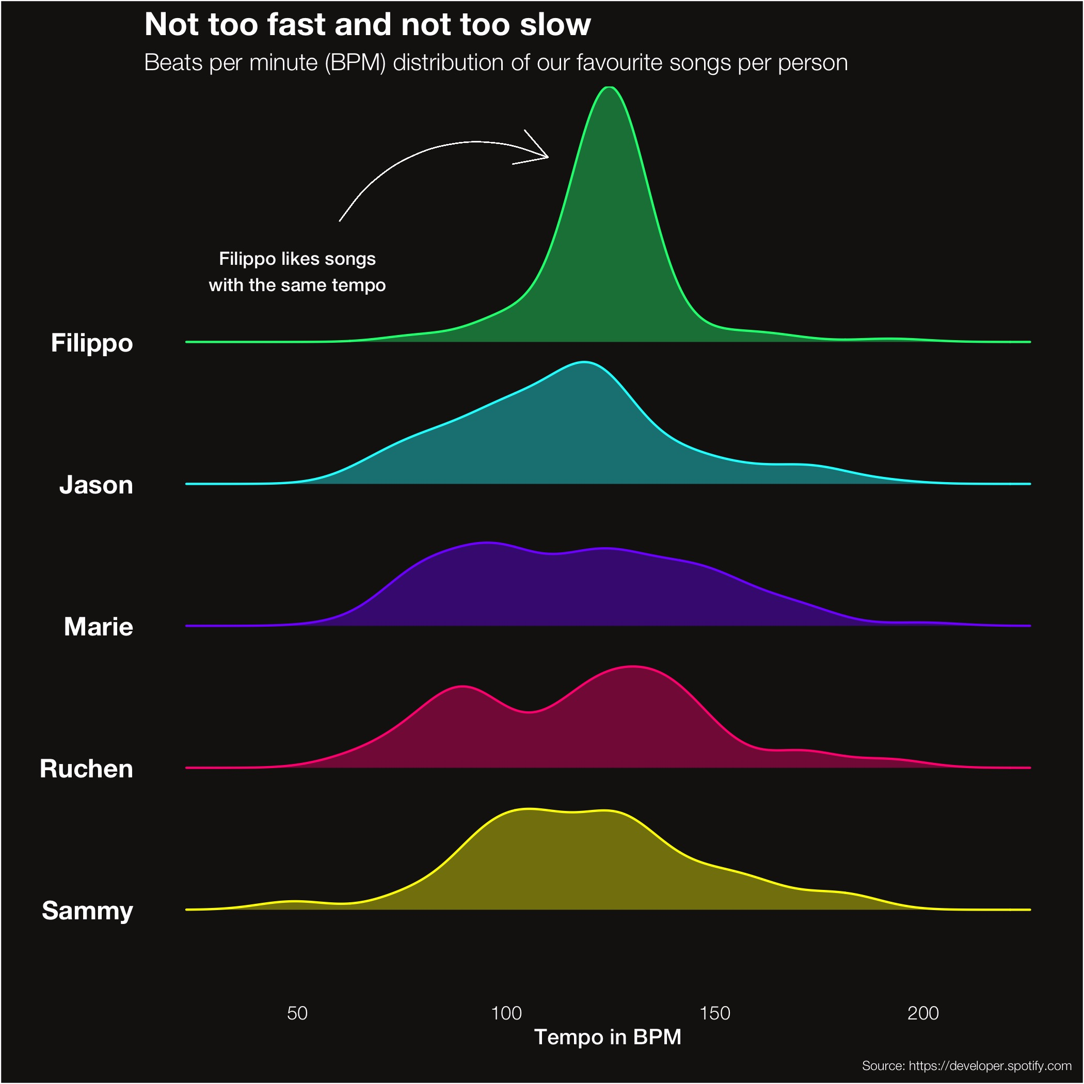
… there are some differences though!
1
Introduction
2
Our preferences
3
Song popularity
4
Conclusion

Slide 8
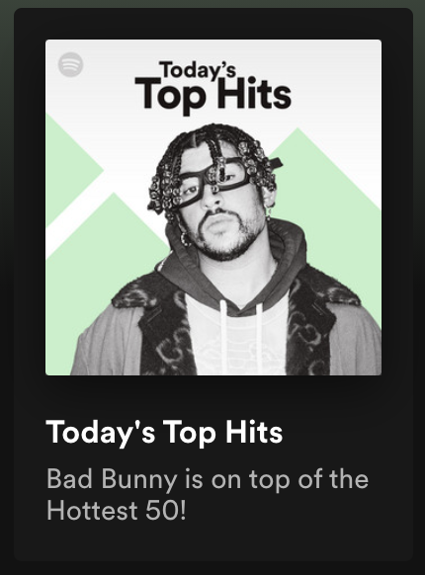
But what makes a song popular?
1
Introduction
2
Our preferences
3
Song popularity
4
Conclusion
Surely the most popular playlist on Spotify will tell us!

Slide 9
1
Introduction
2
Our preferences
3
Song popularity
4
Conclusion

Slide 10
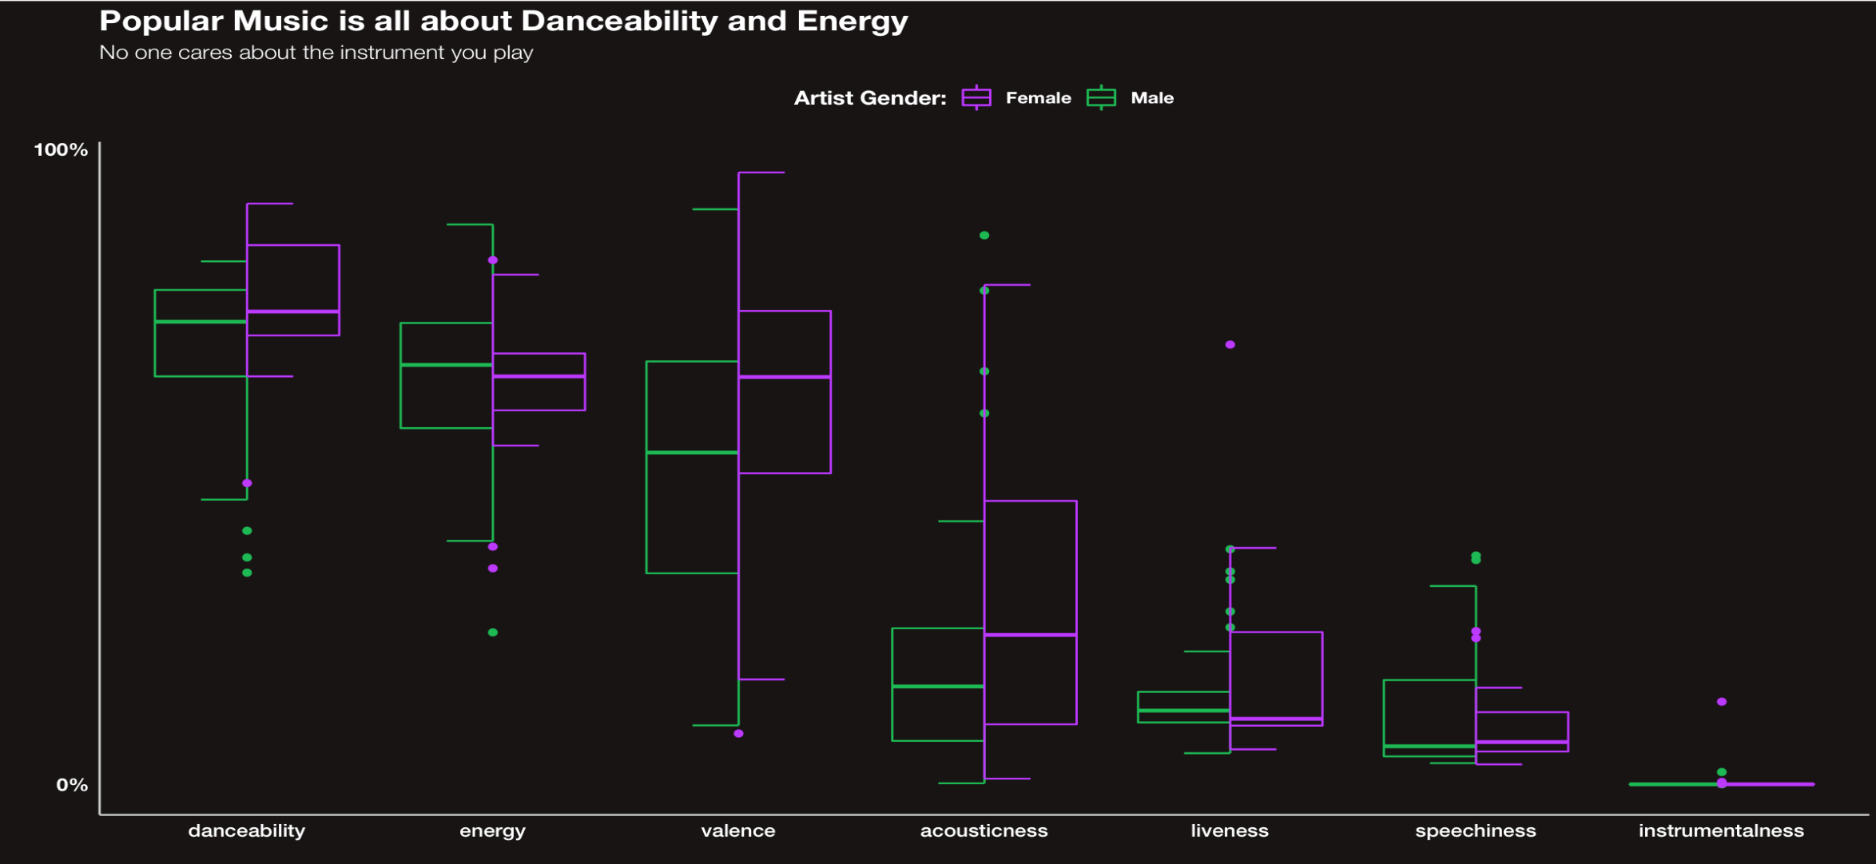
Why are Today’s Top Hits today’s top hits?
1
Introduction
2
Our preferences
3
Song popularity
4
Conclusion

Slide 11
But this is only what makes today’s music popular
1
Introduction
2
Our preferences
3
Song popularity
Let’s look at more representative data and see which factors are most important in determining popularity
4
Conclusion

Slide 12
What makes a song popular?
1
Introduction
2
Our preferences
3
Song popularity
4
Conclusion

Slide 13
Unfortunately, song popularity isn’t this simple
1
Introduction
2
Our preferences
3
Song popularity
We have to take more factors into consideration…
4
Conclusion

Slide 14
Unfortunately, song popularity isn’t this simple
1
Introduction
2
Our preferences
3
Song popularity
We have to take more factors into consideration…
Genre
Content
Time period
Location
4
Conclusion

Slide 15
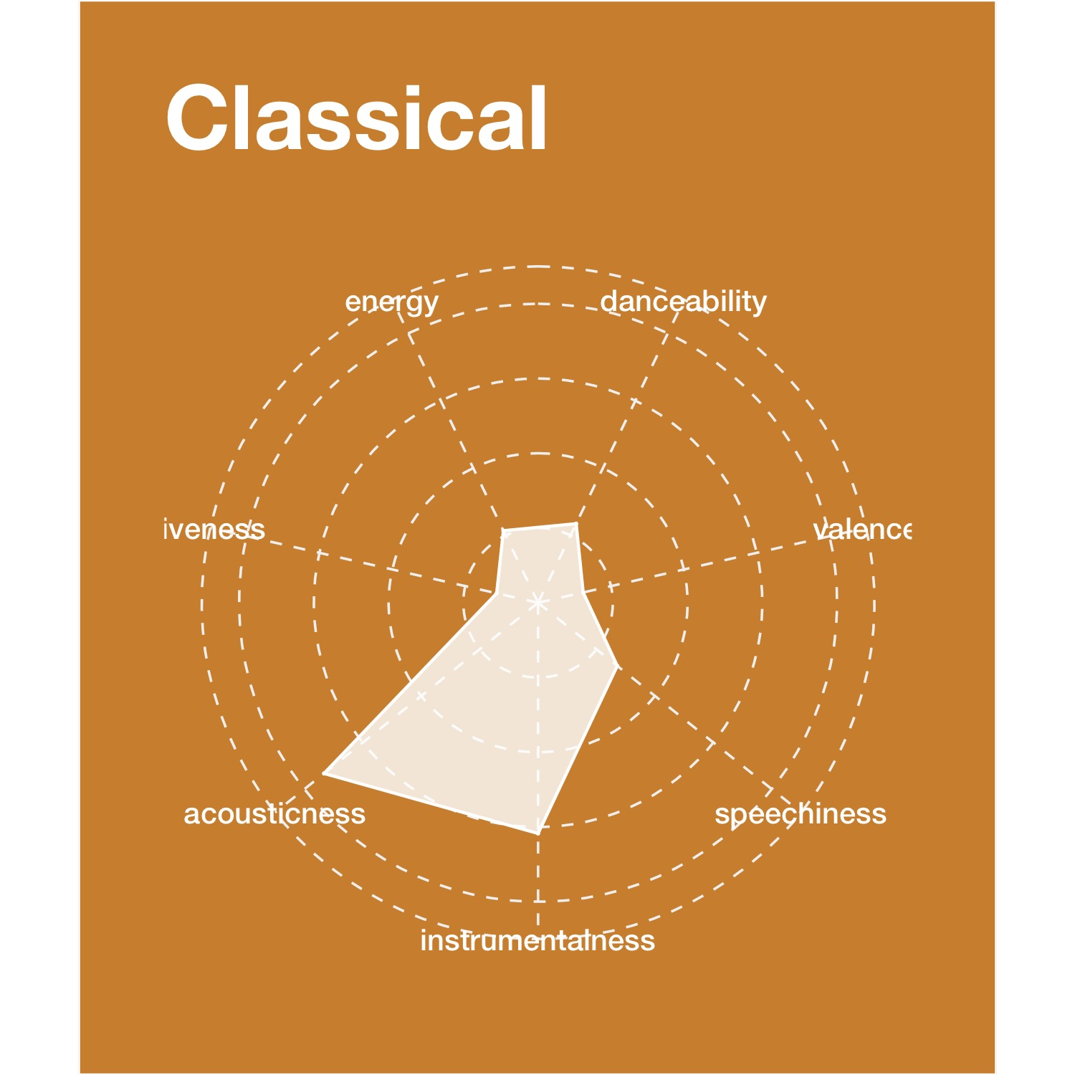
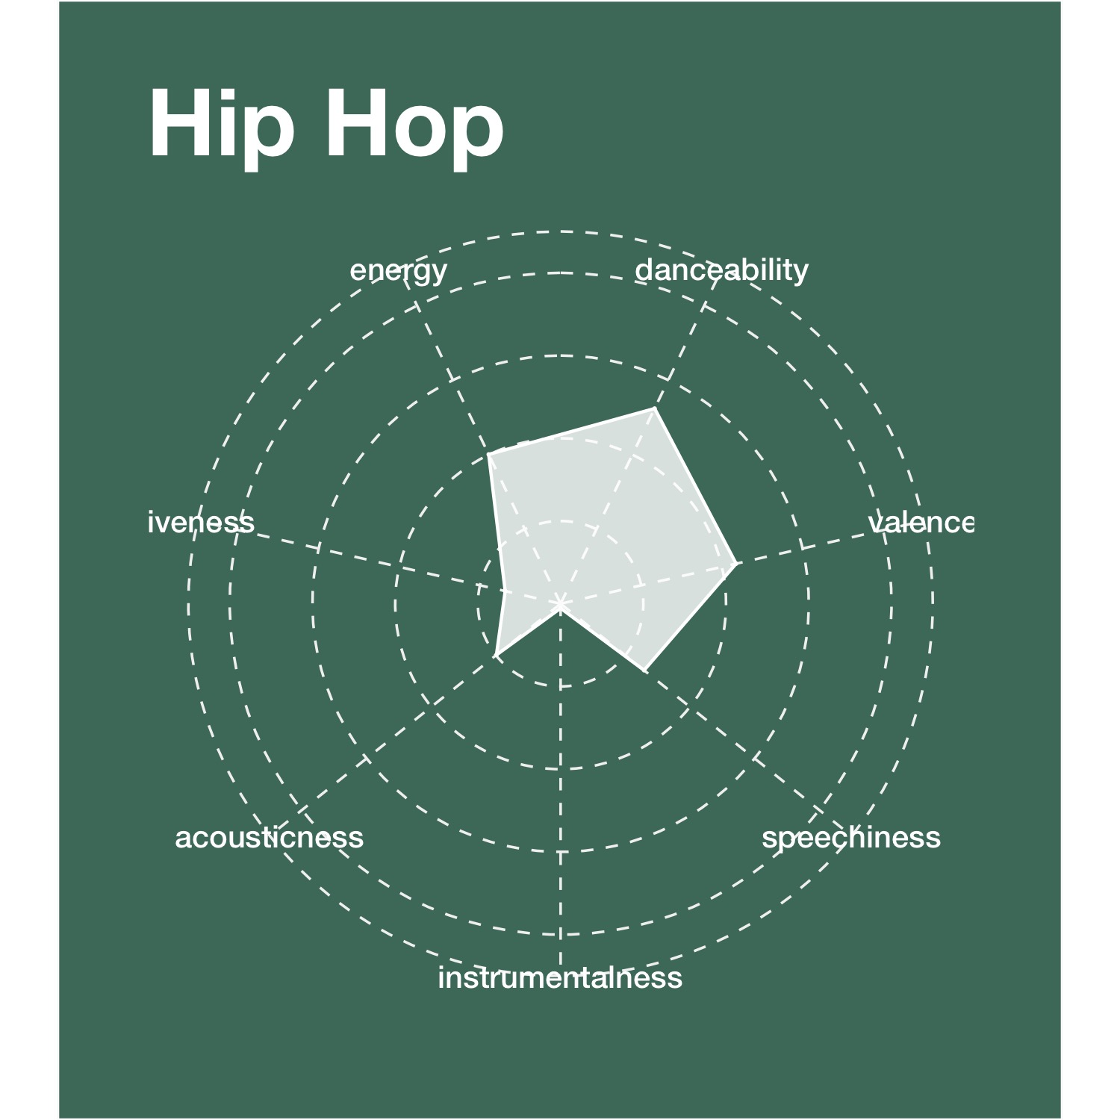
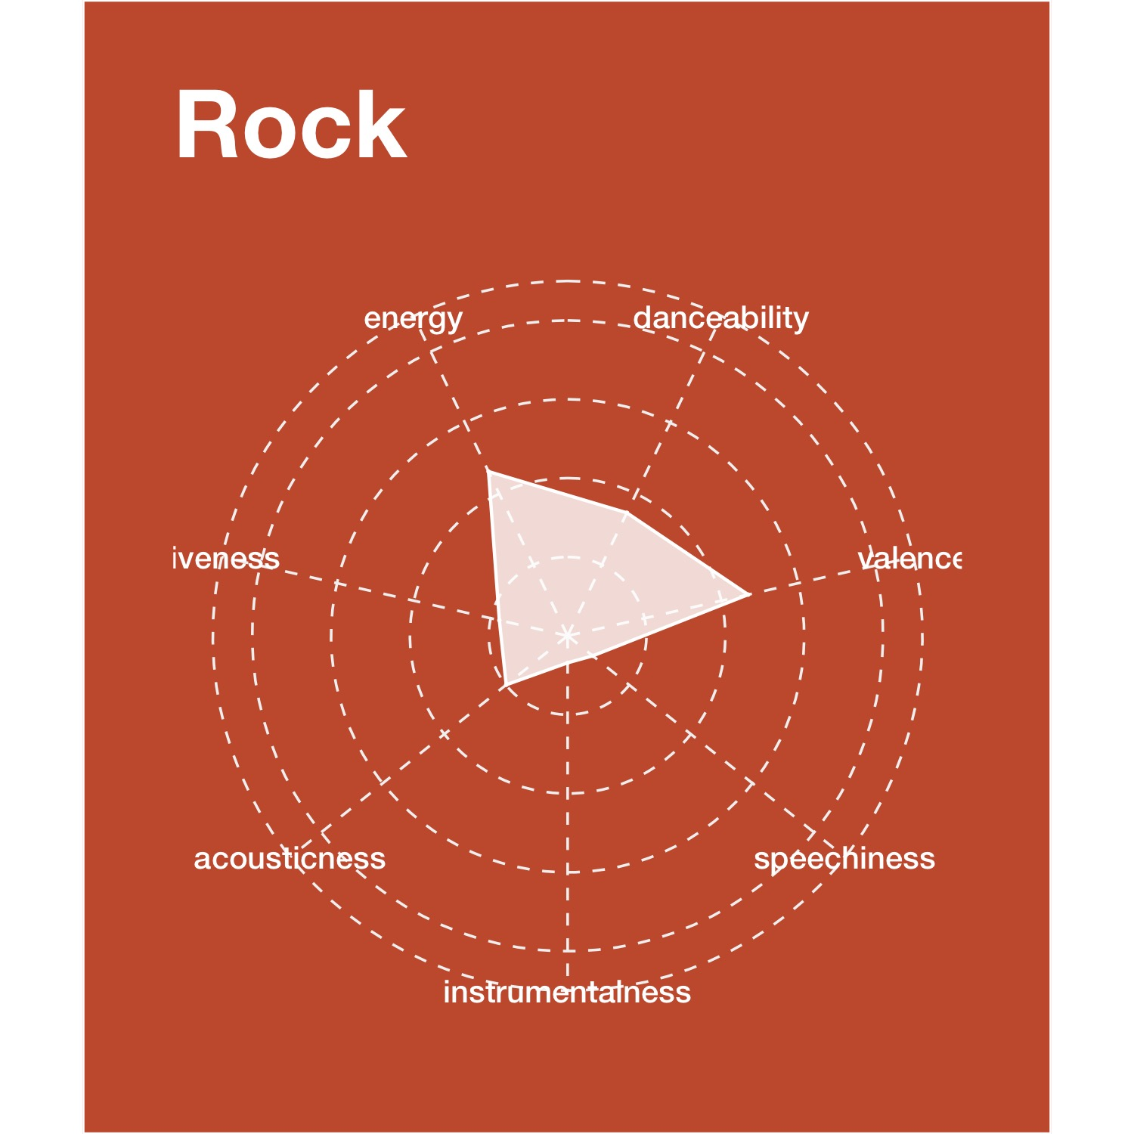
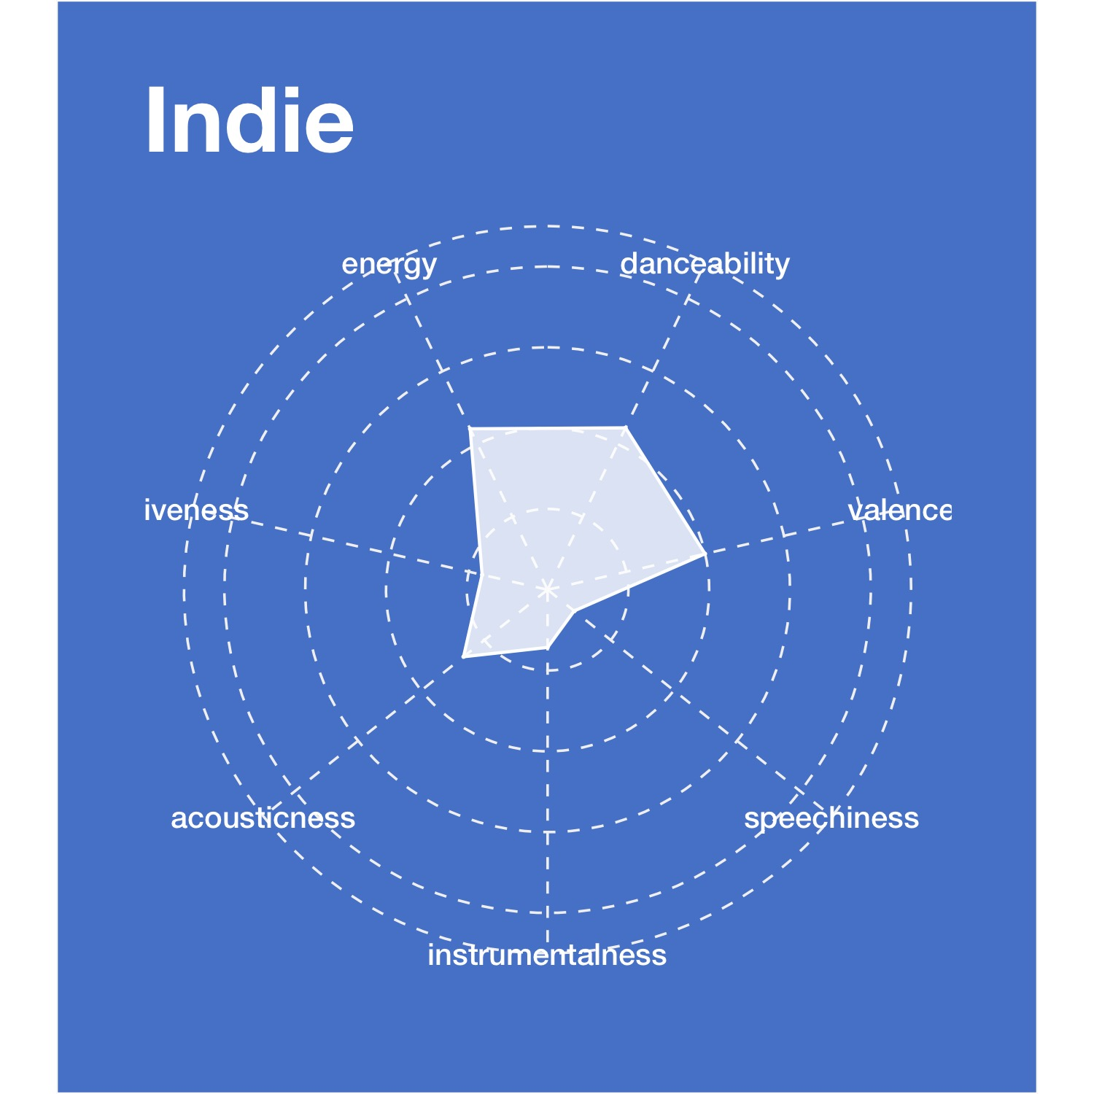
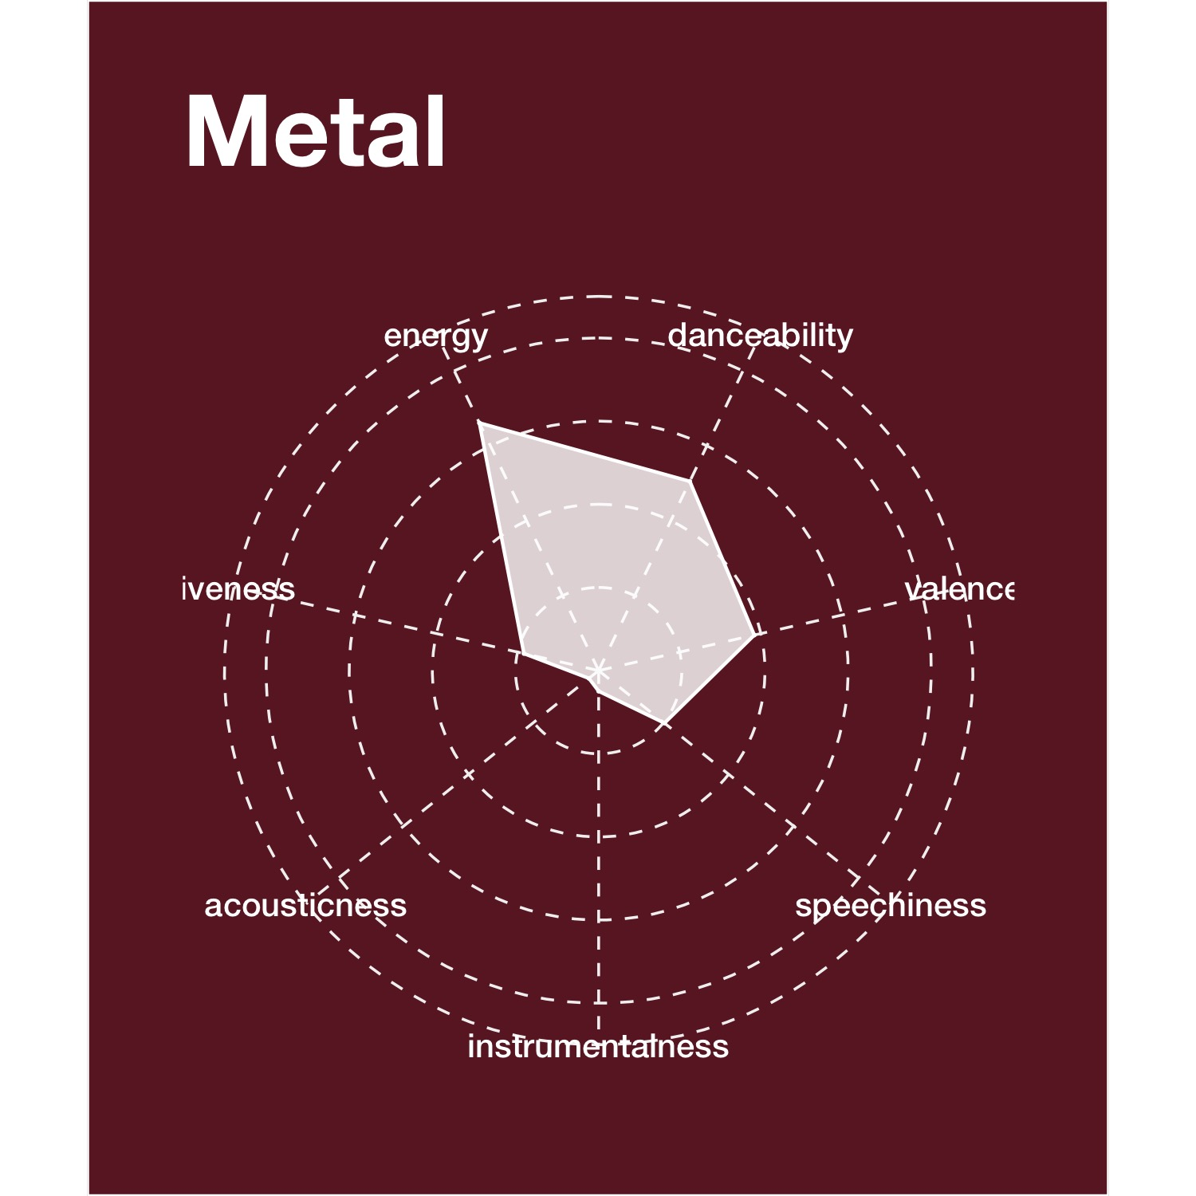
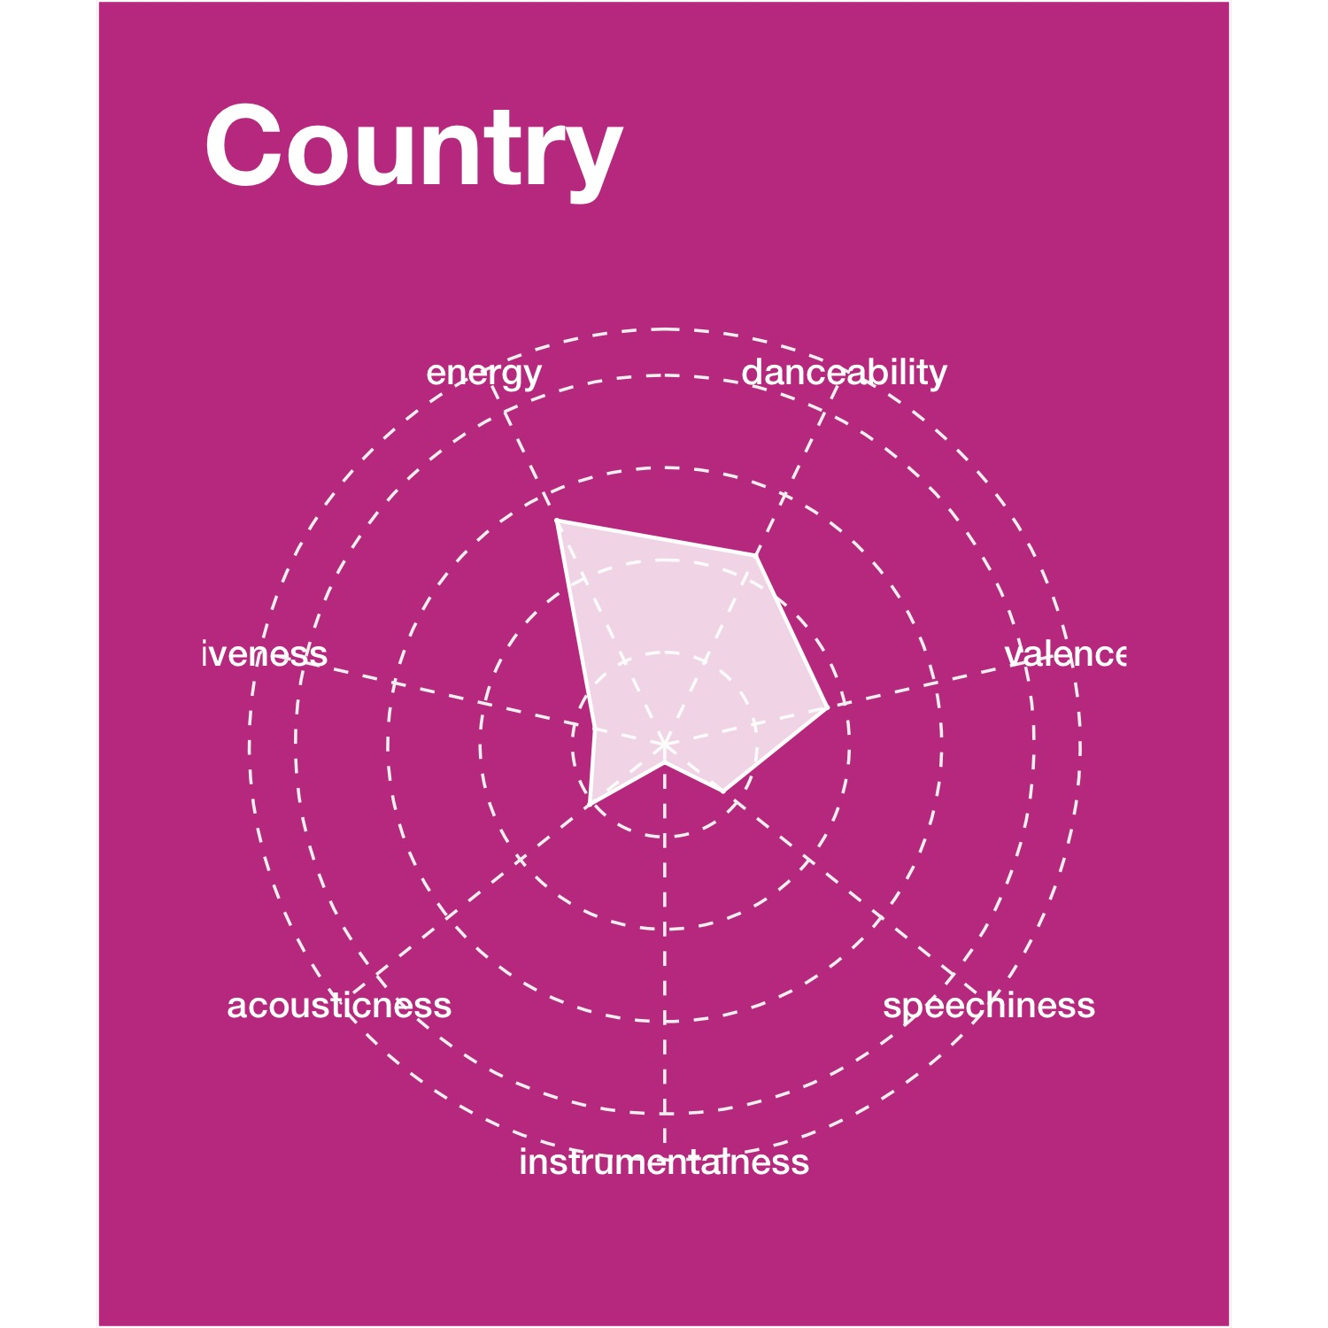
Music preferences differ highly by genre Track dimensions for some of the most popular genre playlists
1
Introduction
2
Our preferences
3
Song popularity
Genre
Content
Time period
Location
4
Conclusion
Notes:
Spotify has identified over 1,300 genres in the world

Slide 16
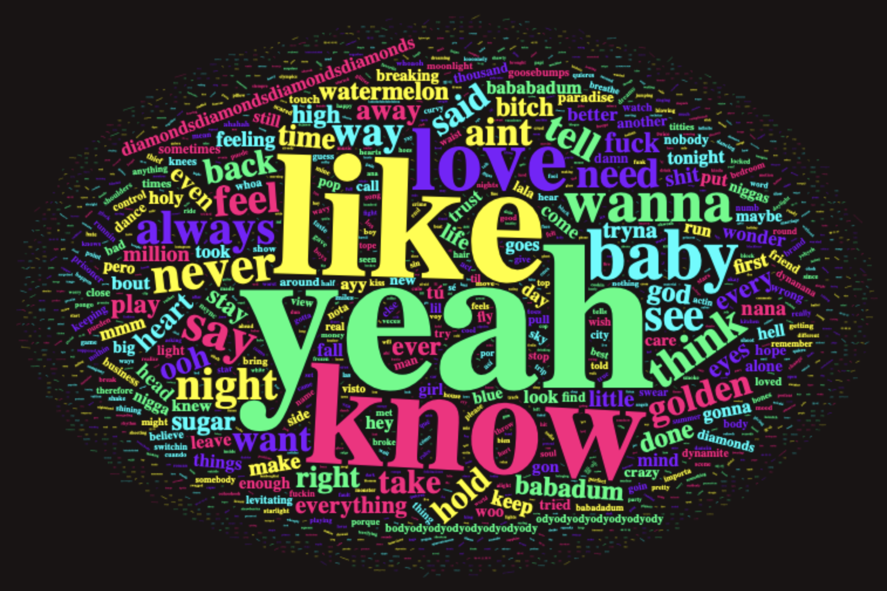
Lyrics and their meaning highly influence songs
The most frequently used words in Today’s Top Hits
1
Introduction
2
Our preferences
3
Song popularity
Genre
Content
Time period
Location
4
Conclusion

Slide 17
How did music evolve over the last 100 years?
1
Introduction
2
Our preferences
3
Song popularity
LET’S HAVE A LOOK
Genre
Content
Time period
Location
4
Conclusion

Slide 18
Loud, energetic and danceable music gained more popularity while use of instruments became less preferred
Song feature evolution over the past 100 years
1
Introduction
2
Our preferences
3
Song popularity
Genre
Content
Time period
Location
4
Conclusion
Notes:
Find out more here: https://public.tableau.com/profile/ruchen8489#!/vizhome/Group14_Spotify_ByDecade/Story?publish=yes

Slide 19
Some artists and songs still remain relevant today
Artist and song popularity by decade
1
Introduction
1960s
2
Our preferences
3
Song popularity
2010s
Genre
Content
Time period
Location
4
Conclusion
Notes:
Find out more here: https://public.tableau.com/profile/ruchen8489#!/vizhome/Group14_Spotify_ByDecade/Story?publish=yes

Slide 20
Success is short, enjoy it until someone else hits #1
The most prolific artists per decade
1
Introduction
2010
2
Our preferences
3
Song popularity
Genre
Content
Time period
Location
4
Conclusion

Slide 21
And how does music taste differ geographically?
1
Introduction
2
Our preferences
3
Song popularity
LET’S HAVE A LOOK
Content
Genre
Time period
Location
4
Conclusion

Slide 22
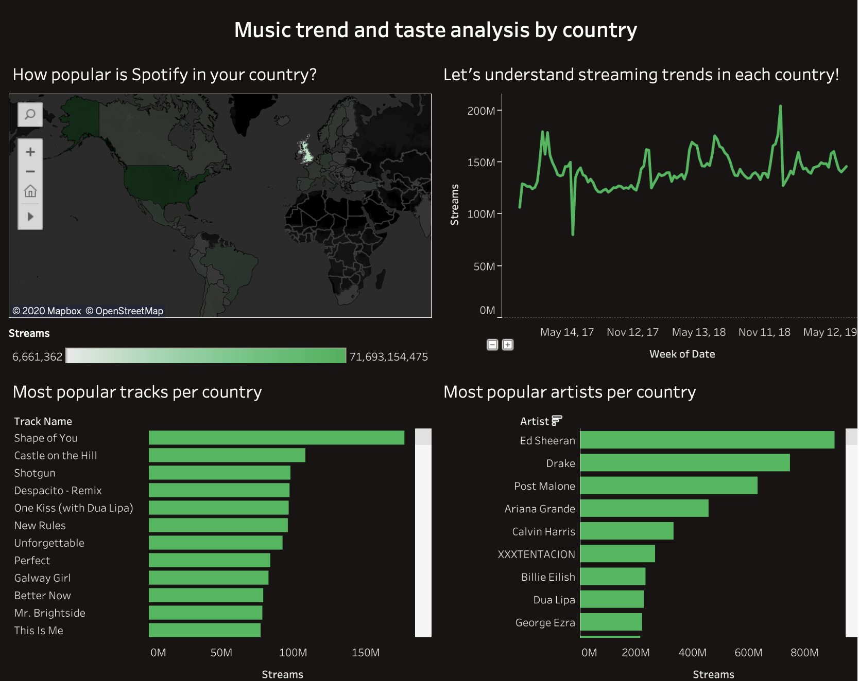
Other countries, other customs
Streaming trends per country
1
Introduction
2
Our preferences
3
Song popularity
Content
Genre
Time period
Location
4
Conclusion

Slide 23
There is no one way to understand and predict music preferences and popularity
1
Introduction
However similar they are, every individual’s music taste is unique
Today’s popular music all about danceability and energy; it is less about live music, acoustic tracks or use of actual instruments
Acoustic songs, conveying positive moods or using a lot of speech seem to negatively influence song popularity while danceable songs with high energy and explicit words seem to guarantee success - Caution though! Music is too diverse to be generalised into one statistical model
We must keep the following in mind
Music preferences differ by genre
Lyrics and their meaning highly influence songs
Music taste and preferences evolve over time; however, some artists and songs survive time and are still relevant today
Either way, success is often short and all artists try to survive in a highly competitive music industry
Music taste and preferences differ by region; some songs reach people worldwide while others stay local
2
Our preferences
3
Song popularity
4
Conclusion
Notes:
https://developer.spotify.com/documentation/web-api/reference/object-model/

Slide 24
Everyone’s music taste is unique
1
Introduction
2
Our preferences
3
Song popularity
You can explore the data as much as you like – at the end of the day, only you know what makes you like a song!
4
Conclusion

Slide 25
Thank you for listening!

Slide 26

Explore more of your favourite music here
Time period
Location
DIY
SCAN ME

Slide 27
Sources
1
Introduction
Spotify for Developers API & our own Spotify playlists
Spotify Dataset 1921-2020, Audio features of 160k+ songs released in between 1921 and 2020 (https://www.kaggle.com/yamaerenay/spotify-dataset-19212020-160k-tracks/discussion)
Spotify Top 200 hits per day per country (https://spotifycharts.com/regional)
Song lyrics (https://www.lyrics.com)
2
Our preferences
3
Song popularity
4
Conclusion

